Slide 1
Logic expression normalizer
Object Oriented Language and Theory - Lab
Lecturer: Nguyen Thi Thu Trang, Ph.D.
June 2021

Slide 2
GROUP 3
Full name | Student ID | Assignment
Tran Trung Hieu | 20194764 | Package: column, table Controller and GUI: Main menu Report
To Xuan Hung | 20194772 | Package: minterm Controller and GUI: Input interface Report and Slides
Nguyen Tran Minh Tuan | 20194877 | Package: output Controller and GUI: Output interface Report

Slide 3
Problem statement
Normalize a logic expression using the implementation of the Quine-McCluskey method
The same expression can be implemented using fewer logic gates

Slide 4
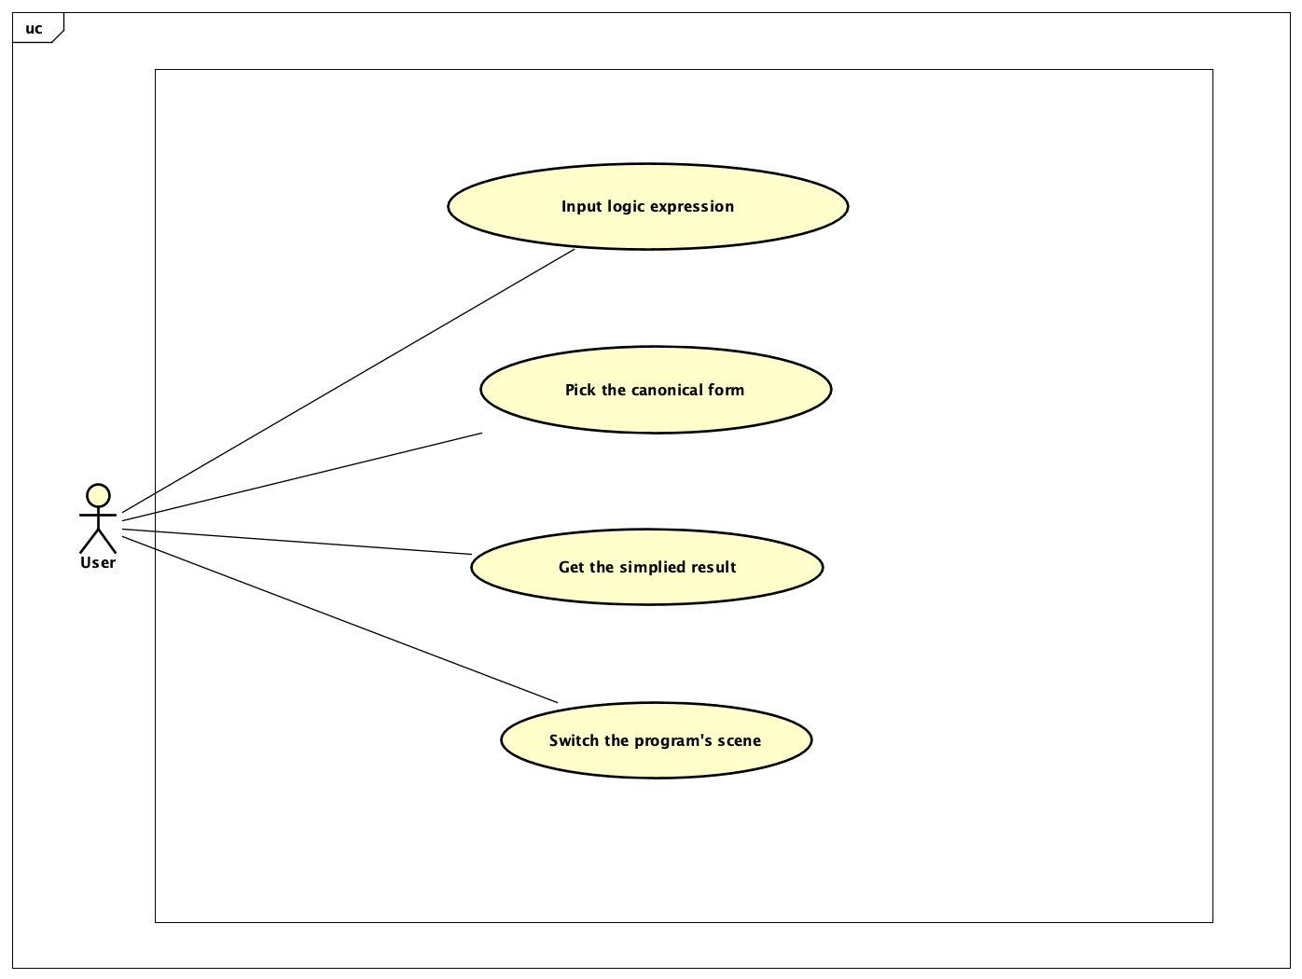
Use case diagram

Slide 5
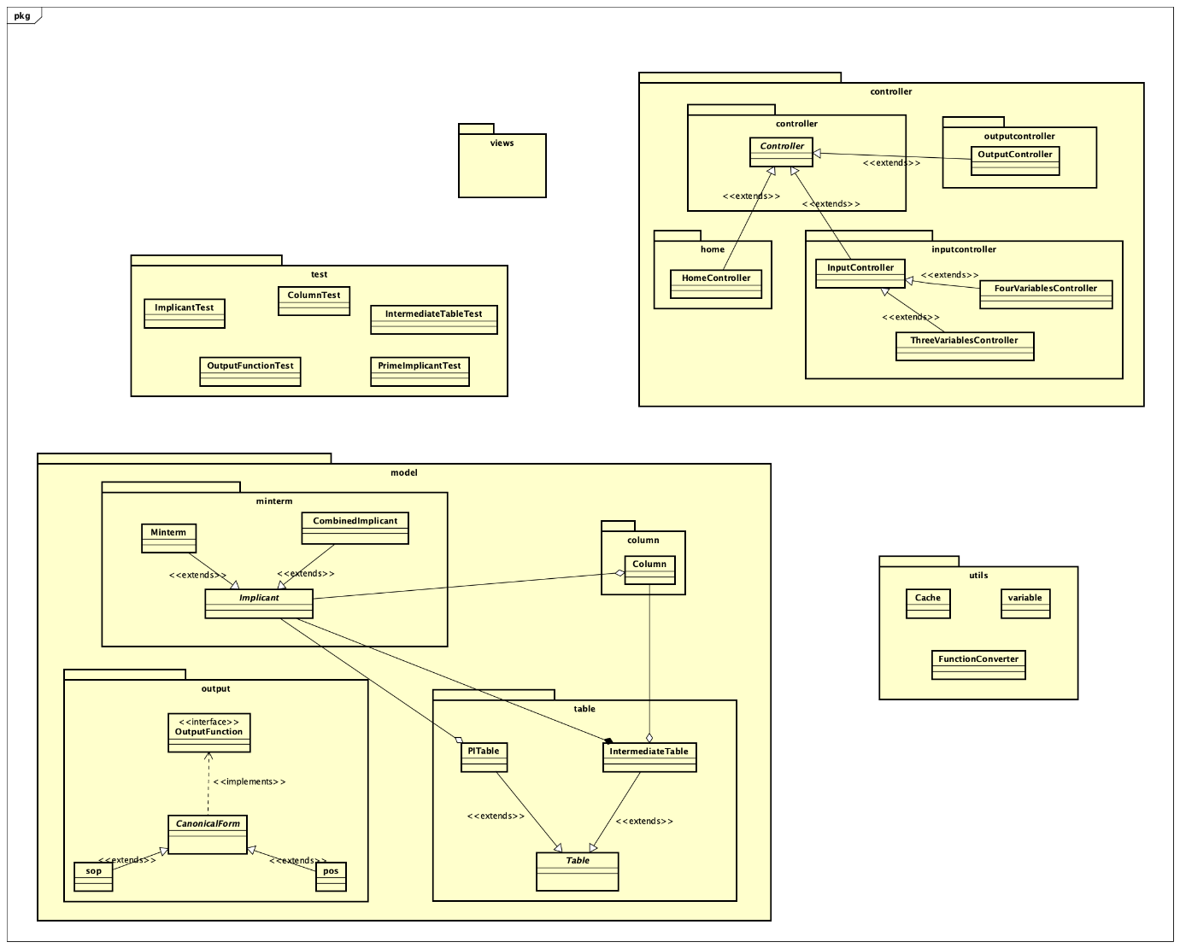
General class diagram

Slide 6
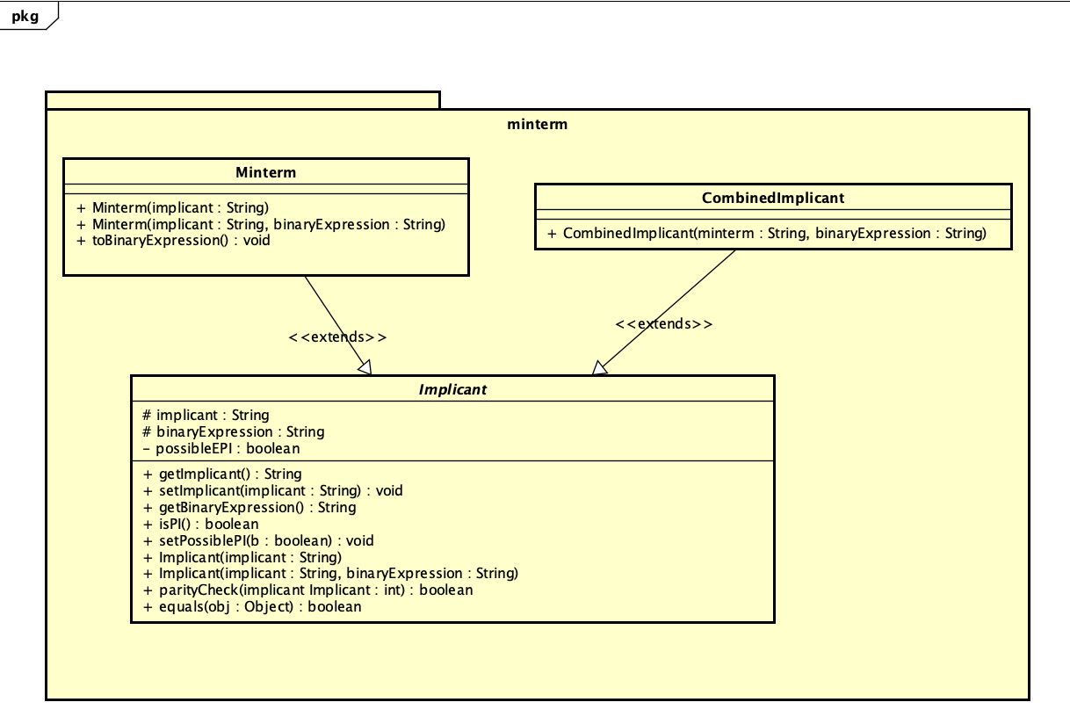
class diagram for minterm

Slide 7
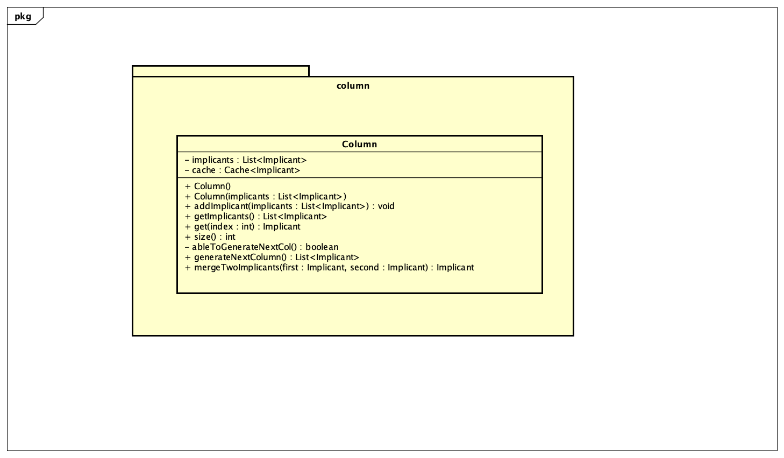
class diagram for column

Slide 8
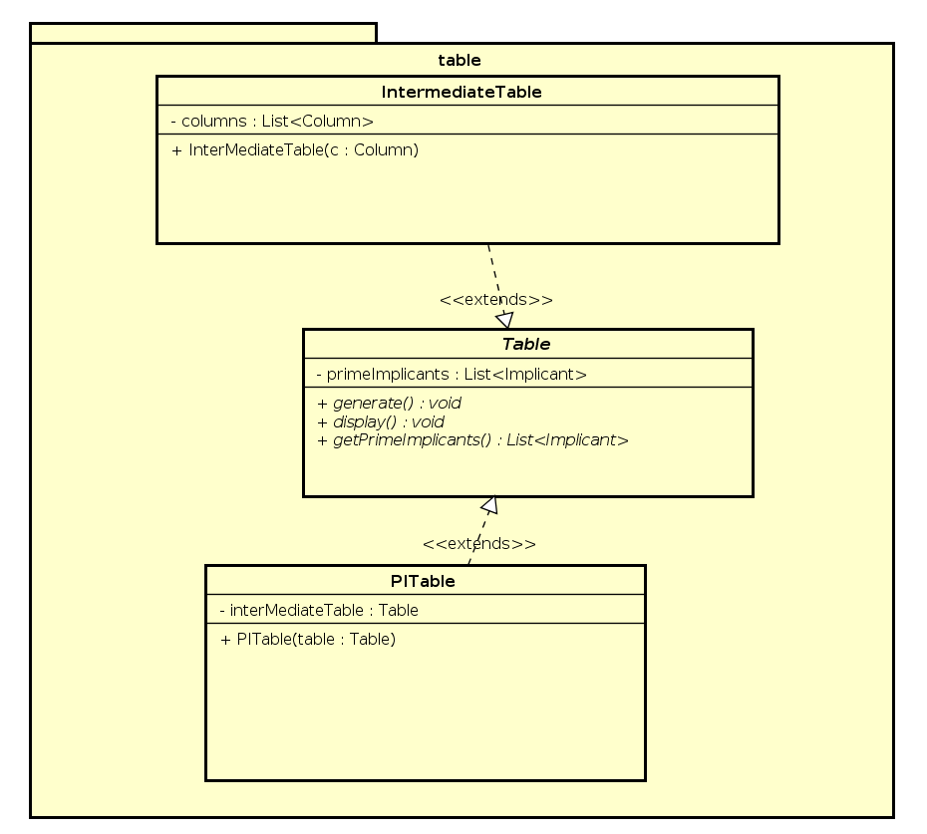
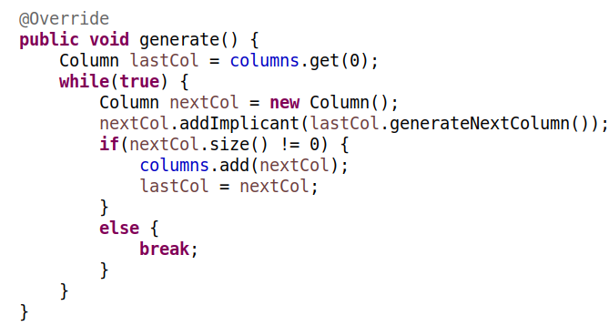
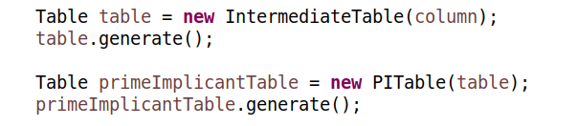
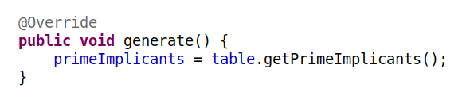
class diagram for table
Notes:
sadasdasdasdsa

Slide 9
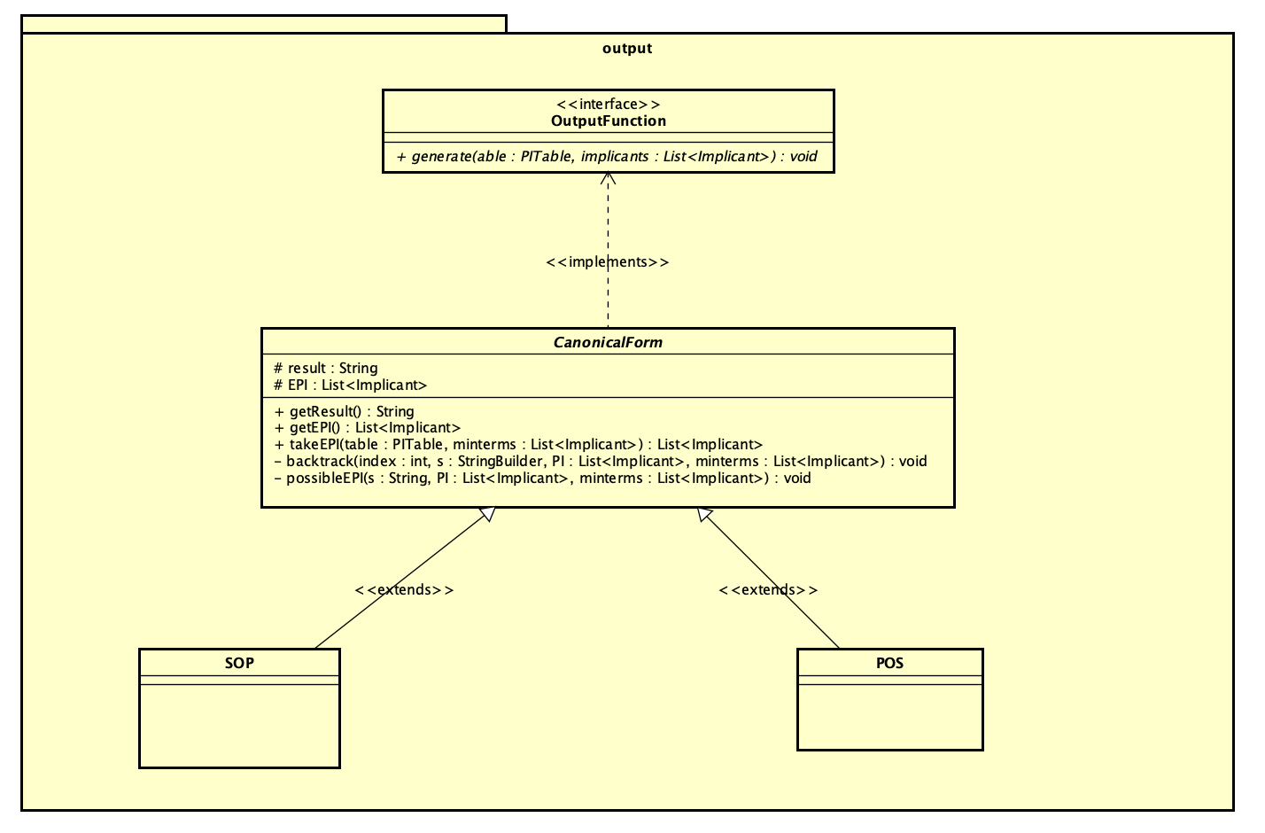
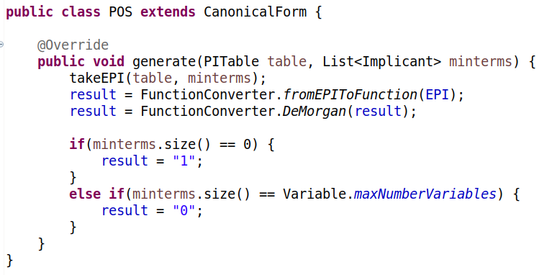
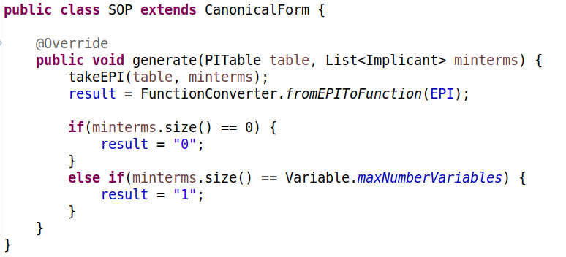
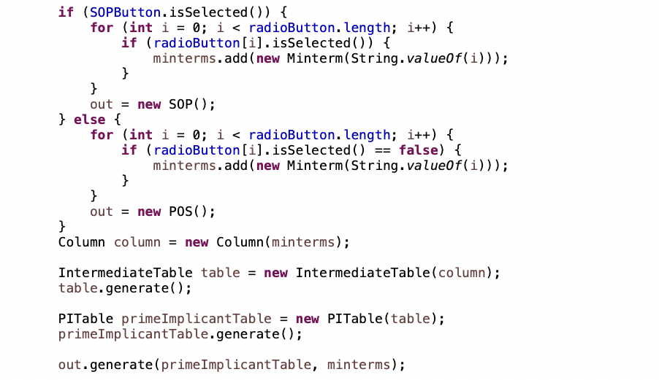
class diagram for output

Slide 10
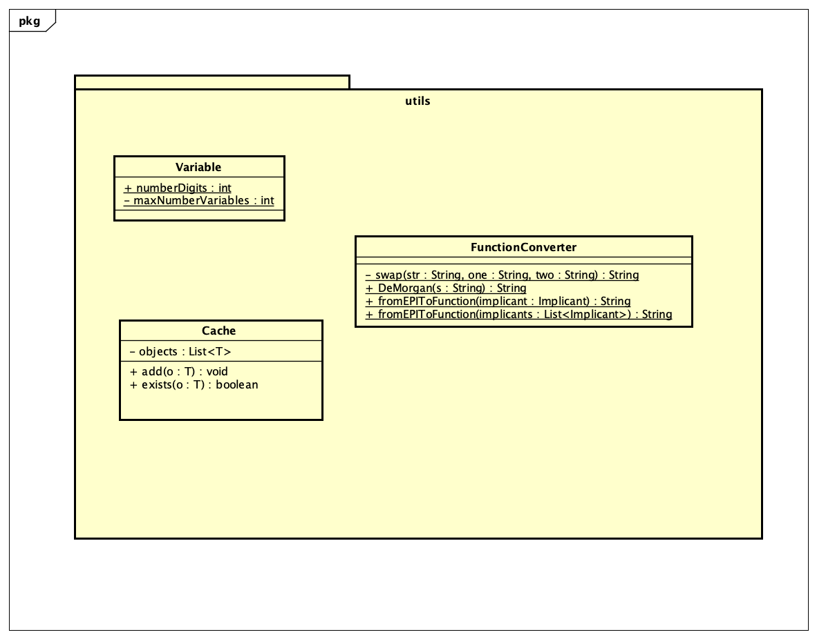
class diagram for util

Slide 11
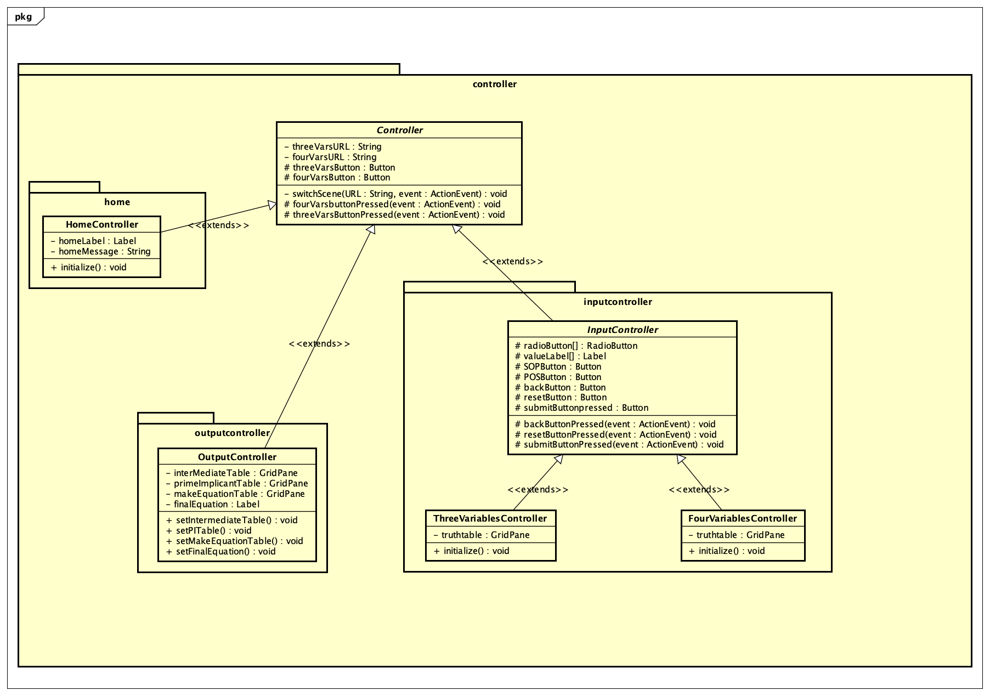
class diagram for Controller

Slide 12
Explanation of oop design
The aggregation relationship is used among Implicant class, the Column class, the PITable and the IntermediateTable class
However, the IntermediateTable must contain at least one column, so the relationship between those two is a strong composite relationship
The IntermediateTable and PITable both inherit the Table class. The SOP and POS class should inherit the CanonicalForm

Slide 13
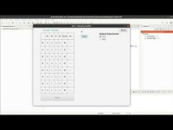
Application demonstration

Slide 14
Thanks

